Slide 1
Cross-Tabs and Chi-Square
R. Garner, DePaul University

Slide 2
A quick overview of crosstabs and chi-square
This data analysis technique is used when both variables are multi-category categorical variables.
We cannot compute a mean or SD for them.
They can be nominal, ordinal, or binary.
Often it is used when one or both variables are binaries.

Slide 3
A couple examples
Is RELIGIOUS AFFILIATION (nominal variable, categories are various religions) related to POLITICAL IDEOLOGY (coded as left, center, right)?
Is RESIDENCE (coded as city, suburb, rural) related to PREFERRED DINNER BEVERAGE (categorized as pop, water, milk, beer, wine, distilled liquor)?

Slide 4
Table layout
Place the predictor variable (independent variable) in the columns. Each category of the predictor variable has its own column.
Place the outcome variable (dependent variable) in the rows. Each category of the outcome variable has its own row.
When we do that, the table will be named: Row Variable by Column Variable.
For example: BEVERAGE CHOICE by RESIDENCE

Slide 5
Beverage by Residence
Let’s pretend we asked people in three different types of communities (city, suburb, and rural) to name their FAVORITE dinner beverage.
Then we created a data file for all of our cases: in one column we put their residence and in another column we put their favorite beverage.
Based on this data, we are going to create a cross-tab.

Slide 6
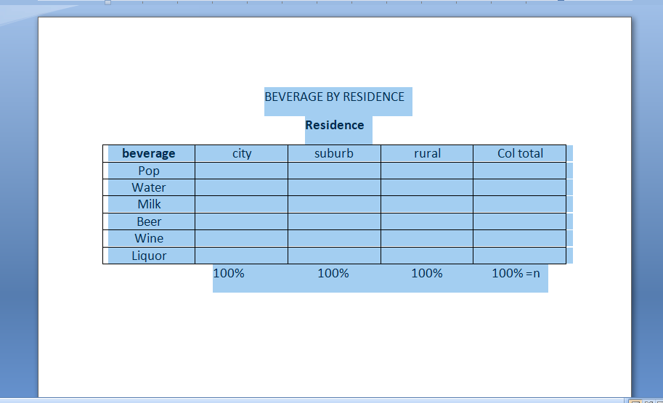
Beverage by Residence: table layout

Slide 7
What’s in each cell?
In the upper left-hand cell, we see the count of how many people who live in cities indicated that pop is their first choice.
In the third cell down in the Suburb column, we see the count of how many suburbanites picked milk as their first choice.
Etc. (sorry, tea and coffee drinkers—the table would be very large!)

Slide 8
Row and Column Totals
The furthest right column of the table shows the ROW Totals—the breakdown of the row variable for all the cases. Each number shows how many cases fell into each category of the Row (outcome) variable.
The bottom row of the table shows the COLUMN Totals—the breakdown of the column variable for all the cases. Each number in this bottom row shows how many cases fell into each category of the Column (predictor) variable.
Both the row and the column totals add up to the total sample size.

Slide 9
Putting percents in the table
Compute the percents DOWN EACH COLUMN, not in other places in the table.
You can make this choice in the table set-up (“cells” in SPSS—check percentage in columns).
The percentages that can be seen down a column show us how that specific category of the predictor variable (the one in that column) was distributed in the categories of the outcome variable.
What percent of city people preferred each beverage type: pop, water, milk, beer, wine, and distilled liquors? What about suburbanites? What about rural people?
We will end up with four columns (one for each category of residence, plus the column totals) and each one will ADD UP TO 100%.

Slide 10
Beverage by Residence: table layout for percentages—down the columns!

Slide 11
Now we can answer our question!
Our question was: Do people who live in cities, suburbs, and rural areas have similar or different choices for their preferred beverage?
For each area of residence, we can see the proportion of people in that category of residence who selected a specific beverage as their favorite type.

Slide 12
Reading the percents
Now we can look at the table and immediately see whether people in the three RESIDENCE categories made similar BEVERAGE choices.
Compare the percentages in the BEVERAGE category (rows) across the three columns of the RESIDENCE categories.
Do the percentage breakdowns in the three columns look similar to each other?

Slide 13
Chi-square and the Null Hypothesis
Our hypothesis test here is that the proportionate breakdown in the outcome variable (the percentage breakdowns down each column) are the same for all the predictor categories.
Null Hypothesis: Rural, urban, and suburban people have the same percentages whose first choice is pop, water, milk, beer, wine, or distilled liquors.
We don’t care what the counts are, only the percentages. The three residence groups might be somewhat different sizes—that is OK as long as the cell sizes don’t get too small.

Slide 14
Null Hypothesis: Expected Values
We compute the expected value for each cell of the table with the formula:
Expected value = (row total) x (column total)/n
So we look down the column at the column total (count); then we look across the row at the row total (count).
Then we multiply these two numbers together and divide by n.
The quotient is the expected value for the cell.

Slide 15
Chi-square computation
We compute a test-statistic called “chi-square” (chi, χ with a hard ch and rhymes with pie) that expresses how different the observed values are from the expected values for Null Hypothesis.
This involves:
Finding the difference between observed and expected counts in each cell
Squaring that difference
Dividing by the expected count
Summing up all of these quotients

Slide 16
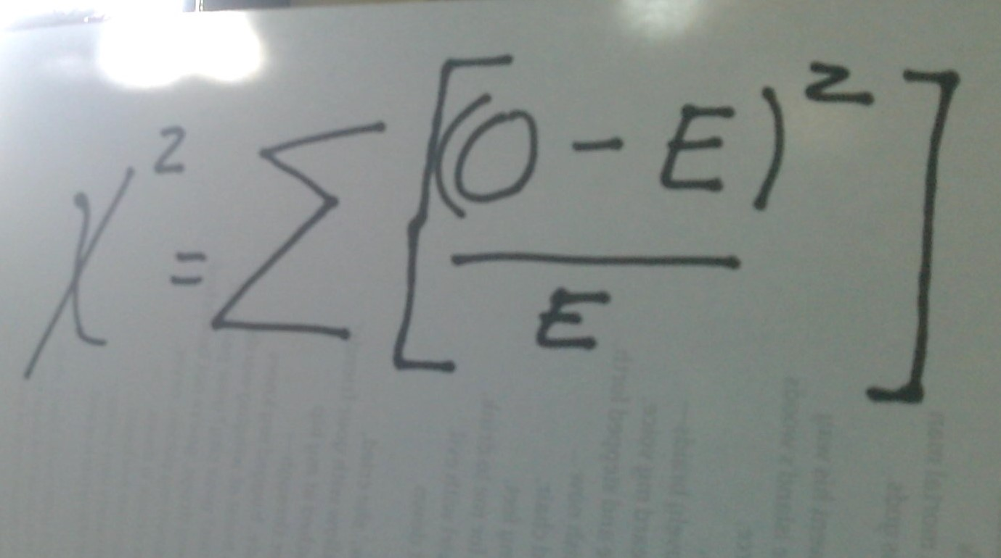
Chi-square formula

Slide 17
Chi-square (continued)
So in our BEVERAGE by RESIDENCE example, we would have 18 cells (six beverage categories, 3 residence categories—look at the table in Slide 7) and we would have to find the expected value for each cell, subtract it from the observed value in our data, square the result, and divide by the expected value.
Then we would have to sum up these quotients for each of our 18 cells. That is the value of chi-square for this table.

Slide 18
Formula explained
On the left side: the symbol that looks like an X squared is χ-squared, chi-squared, the test statistic for categorical data analysis.
On the right side: in each cell, we subtract expected count from observed count, square the difference, and divide by the expected count.
Then we sum the quotients for all the cells in the table. That is the value of chi-squared.
Look it up in the chi-square chart. (Degrees of freedom = (r -1)(c -1) where r and c are the numbers of rows and columns, NOT counting the totals.)

Slide 19
Formula explained (continued)
This calculation is similar to the one for t-tests.
We look at the discrepancy between the observed value(s) in the sample data and the value(s) expected under the null hypothesis.
If this discrepancy is large (large calculated test statistic), it is improbable that the null hypothesis is true for the population. The sample result is evidence against it, and we can say that the discrepancy is “statistically significant.”

Slide 20
Chi-square and its p-value
Each chi-square has “degrees of freedom” calculated as (rows – 1)(columns -1).
In this case, df = (6 – 1)(3 – 1) = 10.
We look up the chi-square we just calculated in a table of the chi-square distribution and ascertain whether it falls in the critical region and what its p-value is.
P < .05? Hurrah, we can reject the null hypothesis! The expected and observed distributions are different, and the two variables are very likely related.
If p is too large, it means the observed counts and the counts expected under the null hypothesis are too close, and we cannot reject the null hypothesis.

Slide 21
Experiment with the table in Slide 7
You can think about what the table might look like if the first choices of a beverage are similar or different for the three different resident categories.

